Slide 1
Cloud Computing (W4153_2025_03)
Lecture 1: Course Overview and Technical Introduction
Lecture 1: Course Overview and Technical Introduction © Donald F. Ferguson, 2025

Slide 2
W4153 Introduction to Databases:
Faculty do not manage waitlists for some courses, including W4153.
The academic admin staff in the CS Department manages the waitlist, priorities and enrollment.
You should contact advising email:
ug-advising, ms-advising, or phd-advising @cs.columbia.edu

Slide 3
Contents
Course overview:
What you really care about – homework, exams, grading
About your instructor and teaching assistants
Course objectives
Approach to lectures and reading material
Student resources and environment
Introduction to core concepts
Cloud computing taxonomy and technology
Microservices
Representational State Transfer (REST)
Architecture and modeling
Agile development
Next steps

Slide 4
Course Overview

Slide 5
Homework and Grading
There are no exams. This is a projects course.
Projects
You will form 5 person teams. Each team
Will have a “name.”
Designated focal point/contact point for communication from instructor and TAs.
Everyone on the project gets the same grade.
You can define your own projects, i.e. the application you want to implement.
I will identify a set of concepts presented in lectures. Your project will receive “points” for each concept successfully included in your project’s implementation.
Grading
The point total achieved on the final project determines the grade.
You will submit a team written report and give a presentation/demo.
You will implement your project in two week “sprints.”
You submit a status report at the end of each sprint. I will give you a template.
Your team must submit status reports. We will deduct one or two points if your report is incomplete.

Slide 6

About Your Instructor
38 years in computer science industry:
IBM Fellow.
Microsoft Technical Fellow.
Chief Technology Officer, CA technologies.
Dell Senior Technical Fellow.
CTO, Co-Founder, Seeka.tv.
Ansys (current):
Ansys Fellow, Chief SW Architect;
VP/GM, Cloud, AI, Solutions and Developer Enablement BU (CASEBU)
Academic experience:
BA, MS, Ph.D., Computer Science, Columbia University.
Approx. 19 semesters as an Adjunct Professor.
Professor of Professional Practice in CS (2018)
Courses:
E1006: Intro. to Computing
W4111: Intro. to Databases
E6998, E6156: Advanced Topics in SW Engineering (Cloud Computing)
Approx. 65 technical publications; Approx. 12 patents.
Personal:
Two children:
College Sophomore.
2019 Barnard Graduate.
Hobbies:
Krav Maga, Black Belt in Kenpo Karate.
Former 1LT, New York Guard.
Bicycling.
Astronomy.
Languages:
Proficient in Spanish.
Learning Arabic.
I have taught some version of this class 10 times.

Slide 7
About Your TAs
Many of the TAs have taken cloud computing with me. They can relate to your experience in the class and help you be successful.
The remainder have real world experience with cloud, projects, etc.
I ask them to be your advocates. If you are struggling, please contact them and/or me.
Each team will have an assigned TA and meet with the TA every sprint.

Slide 8
Course Objectives
Cloud computing:
Has become mainstream and foundational to modern applications and IT systems.
The structure of cloud applications and infrastructure are fundamentally different and more advanced than most students experience in core CS classes.
By the end of the course:
You will understand many of the critical, core cloud and SW concepts and how to apply them to a solution.
You will be prepared to use the technology in other courses, projects and employment.
Additionally,
We should have fun. This is an amazing area.
You should have a small “capstone” project that you can reference in interviews.

Slide 9
Lectures, Office Hours and Reading Material
Lectures are Friday, 1:10 PM to 3:00 PM
The allocated time slot is 1:10 PM to 3:40 PM.
We will use the 3:00 to 3:40 time slot for discussions, help on projects, etc.
Also, there is a lot of independent reading, study and research, … …
I will record and stream the lectures.
Attendance
I travel 3.5 hours round trip to lecture in person.
There are students that cannot get into this class because classroom size limits the enrollment in the class.
There will be times when you cannot attend in person, and there will be lectures where I cannot attend in person.
Basic respect and courtesy means that you should make every effort to attend unless there is a compelling reason not to attend.
If attendance drops to ridiculously low levels, which it will, I will do something crazy like take attendance of have a “pop quiz.”

Slide 10
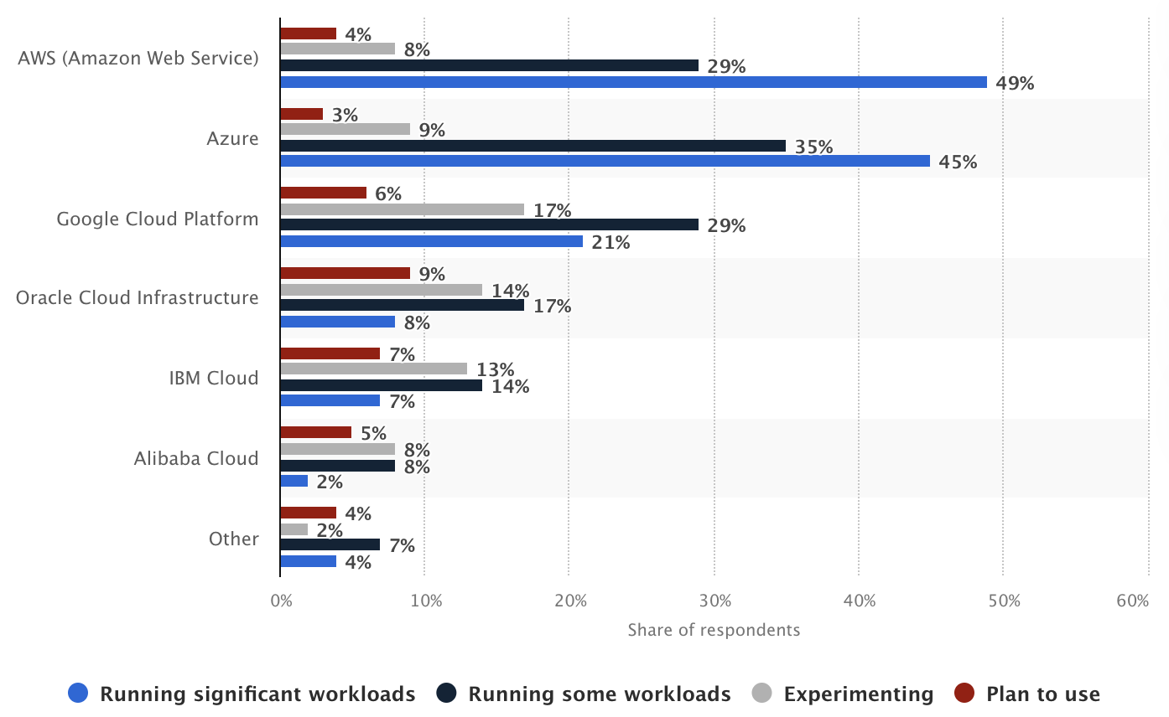
Student Resources, Environment and Systems
Environment and systemsThere are 3 primary cloud service providers:
Microsoft Azure
Google Cloud Platform
Amazon Web Services
The course will focus on concepts and use the clouds for implementations.
Managing costs:
All clouds have “free tiers” and/or “new user” credits.
You must track and manage your costs.
You must set cost controls and alerts.
We have credits for Google Cloud Platform.
I suggest that you also mirror/follow my usage of locally installed SW for development:
PyCharm, DataGrip, WebStorm including cloud usage plugins.
Docker, Minikube, … …
Others will follow during semester.
Resources
There is no textbook.
I will provide links to articles, tutorials, etc. for independent work.

Slide 12
Introduction to Core Concepts

Slide 13
Cloud Computing and Taxonomy

Slide 14
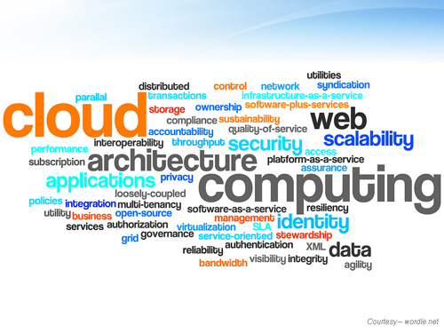
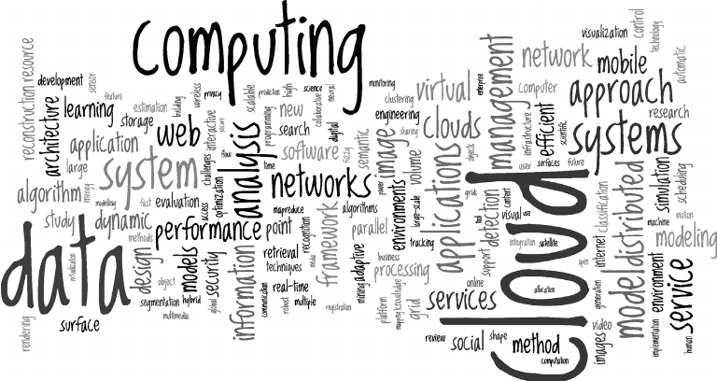
Cloud Computing Concepts
There are many, many cloud concepts, and many different perspectives on each concept.
Most cloud service providers offer their own specific versions of concepts and technology – But the core of the concept is similar.
We explore as many as we can by writing a “complex” application using the technology.
Each element in the application will be very simple, i.e. not deep application domain logic.
The overall application will have many and diverse implementations for elements.

Slide 15
Definitions – As Good as Any of the 10⁶ Definitions
“Simply put, cloud computing is the delivery of computing services—including servers, storage, databases, networking, software, analytics, and intelligence—over the internet (“the cloud”) to offer faster innovation, flexible resources, and economies of scale. You typically pay only for cloud services you use, helping you lower your operating costs, run your infrastructure more efficiently, and scale as your business needs change.” (https://azure.microsoft.com/en-us/resources/cloud-computing-dictionary/what-is-cloud-computing)
“Cloud computing is a delivery model for providing on-demand information technology (IT) infrastructure and services over the Internet. Cloud services are scalable, which means that compute, networking, and storage resources can be adjusted manually or automatically in real time to meet the changing demands of applications and users. Customers can access and use cloud services through freemium, subscription, or consumption-based pricing models. Essentially, a cloud computing environment has five important characteristics that differentiate it from a traditional in-house, local computing environment:
The customer can provision computing resources by themselves on demand.
Resources are provisioned and accessed over the Internet.
Resources are pooled together to serve the needs of multiple customers.
Resources can be rapidly scaled horizontally or scaled down depending on need.
Resource use is controlled by the customer and can be monitored in real-time.”
(https://www.techopedia.com/definition/2/cloud-computing)

Slide 16
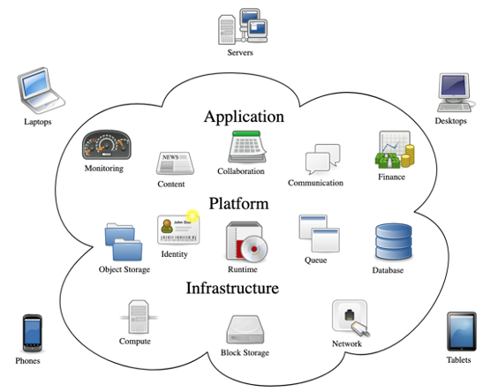
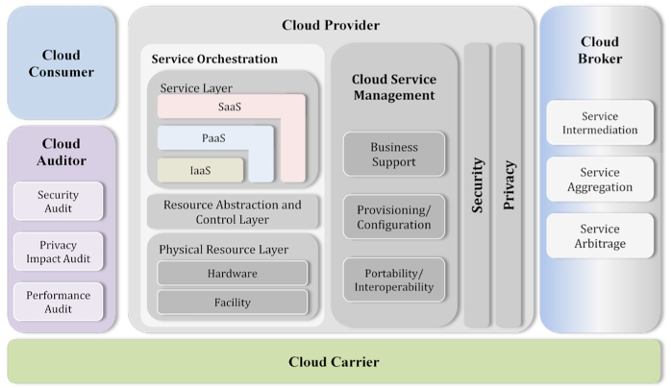
Cloud Computing
NIST Reference Architecture
There are a lot of concepts, aspects, types, … …
Some conceptual models for how it comes together.
Many applications and solutions build on all kinds of things from many clouds.
We will see examples of technology and use during the semester.

Slide 17
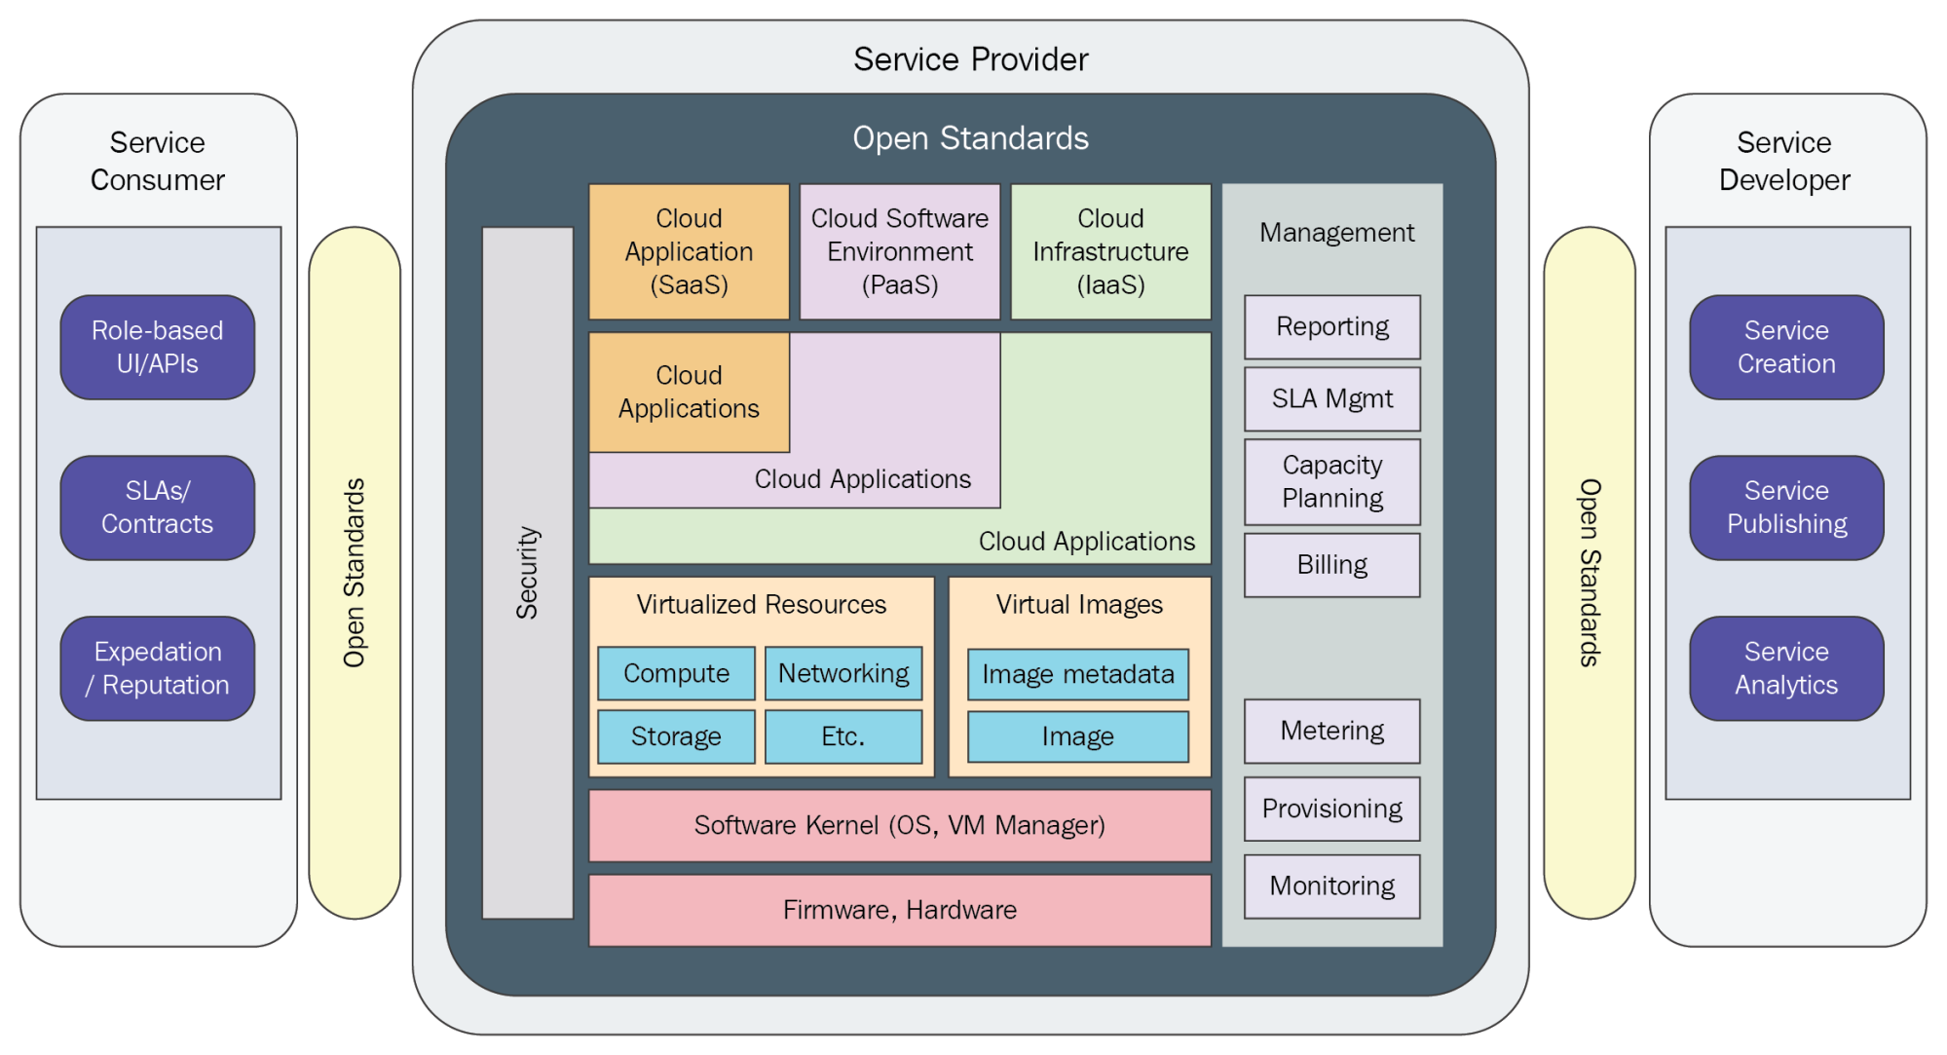

Slide 18
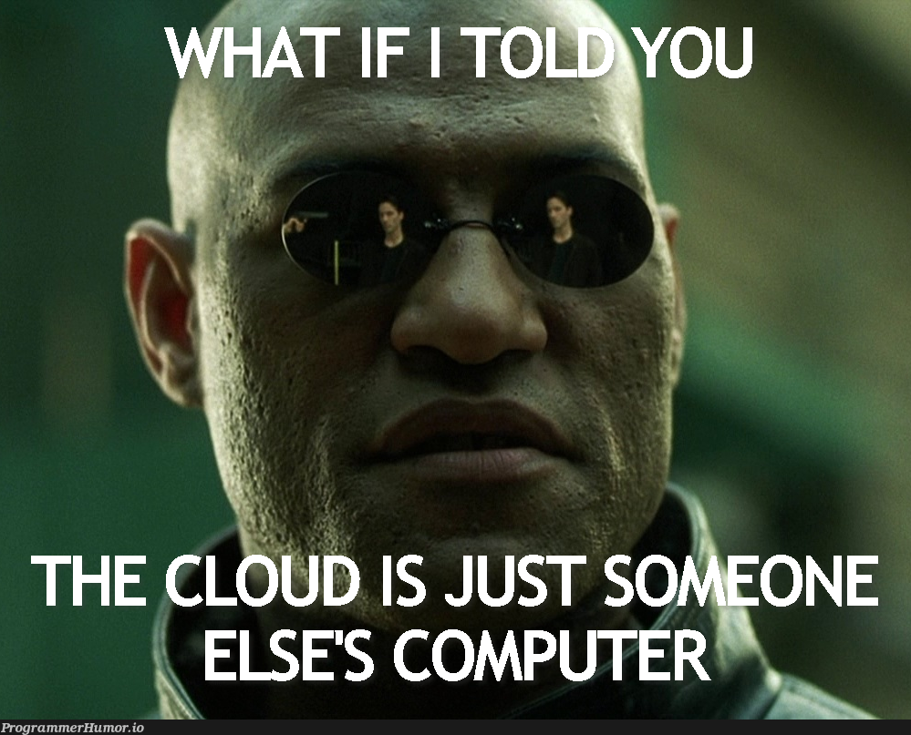
Definitions – The Best One

Slide 19
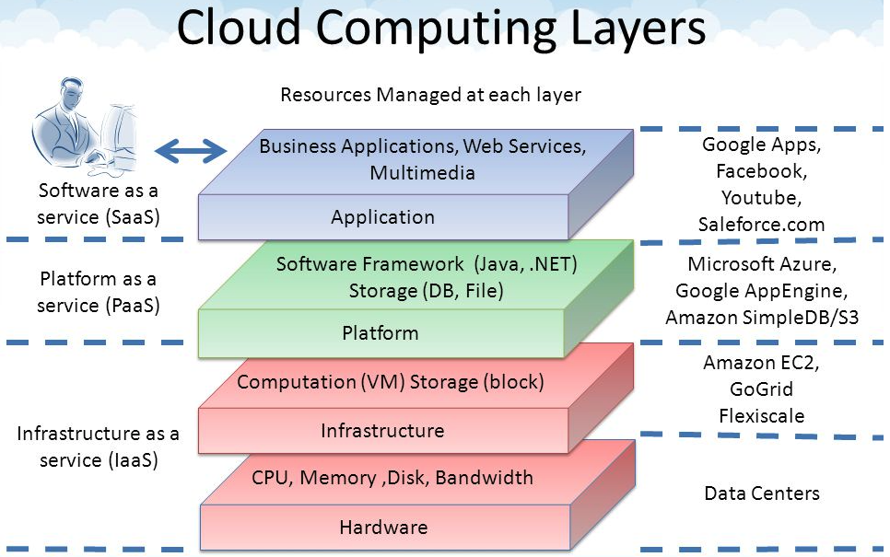
Core Layers
Our first cloud elements will
be IaaS (VMs).
Google Apps
Salesforce, Zendesk, ServiceNow, Concur, ... ...
Office 365, Trello
... ...
Google App Engine, AWS Elastic Beanstalk, ...
AWS SQS, Azure Queuing Service, Google PubSub
DynamoDB, Cosmos DB, ... ...
... ...
AWS EC2, Google Compute Engine, Azure VMs, ... ...
AWS Elastic Container Service, Azure Kubernetes, ... ...
IaaS is compute, storage, networking.
With an OS.
Delivered as a set of VMs and/or containers.

Slide 20
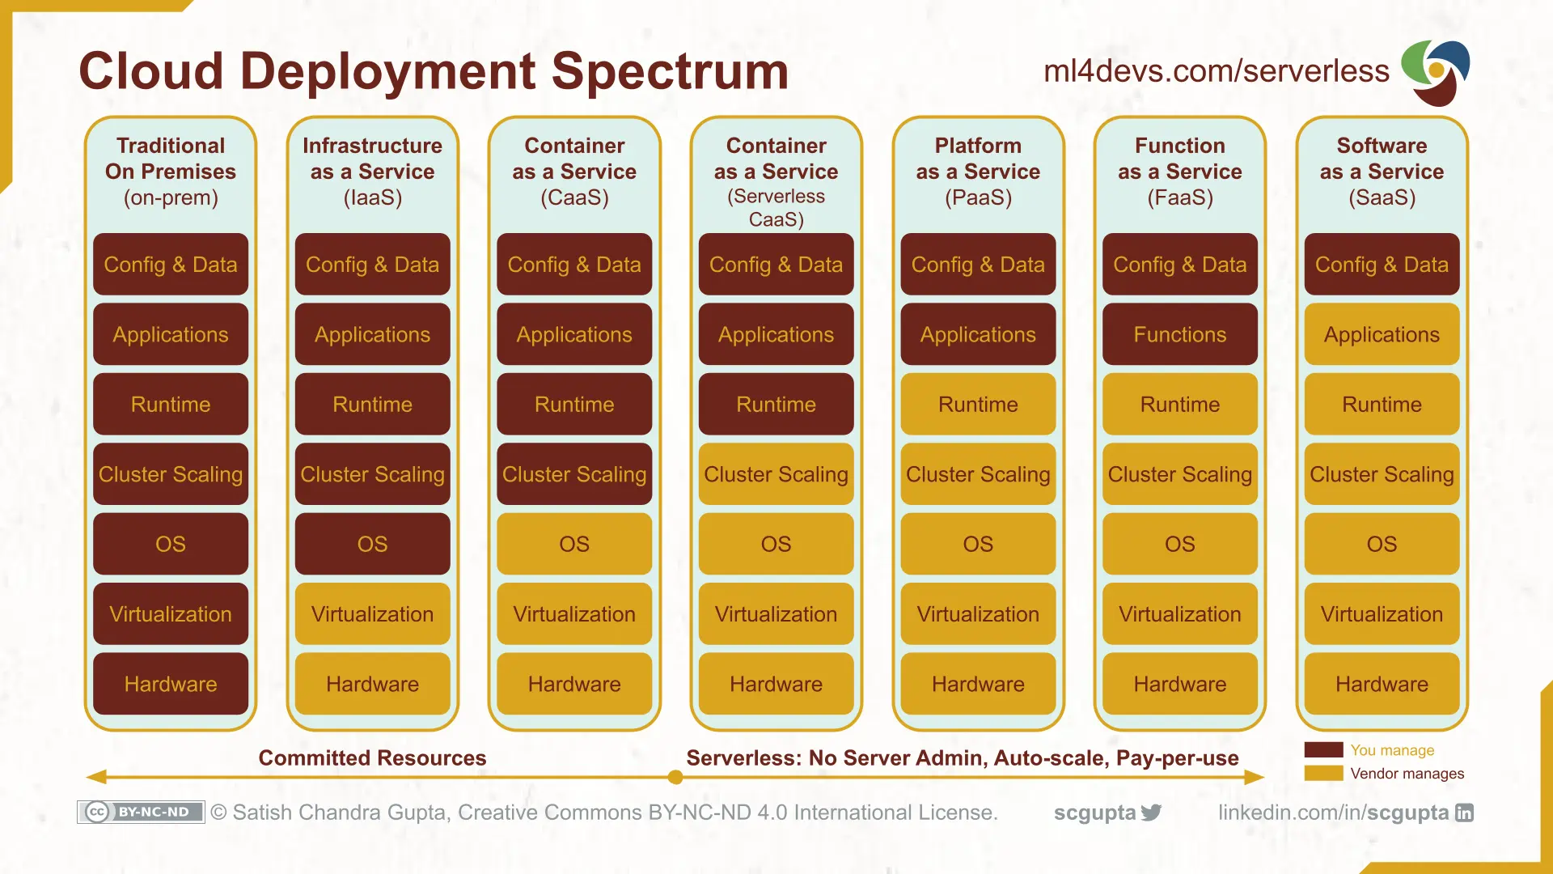
Cloud Layers

Slide 21
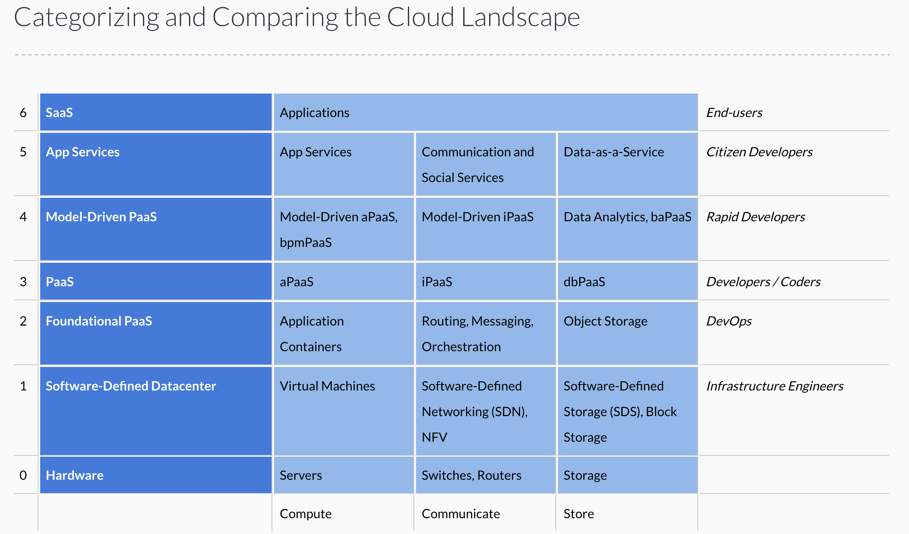
Cloud Concepts – One Perspective
http://www.theenterprisearchitect.eu/blog/2013/10/12/the-cloud-landscape-described-categorized-and-compared/

Slide 22
Why Cloud Computing?
Economy of scale:
There are fixed costs for a data center. One big data center of size N is more cost effective than N data centers.
The cloud service provider (CSP) can “buy in bulk” from HW suppliers.
The average matters:
A company must over provision resources to deal with surges in load/requests. Over provisioning by 3x is common before cloud.
The CSP can rely on averages. Not all N tenants will have surges at the same time. So, the CSP can over provision by a smaller amount than 3*N.
Elastic capacity:
Tenants do not need to over-provision.
They can “request” additional resources when there is a surge and then release. (scale up versus scale down)
Outsource non-core business functions:
A tenant does not want to manage buildings, pay water bills, … …
Buying HW, installing, configuring, monitoring and rebooting, … is a total downer.
The cloud takes over many systems and applications management and operations tasks.
Capital versus Operational Cost: Buying a house versus renting a hotel room.
On premises, non-cloud resources require capital investment, depreciation, ROI, … …
Cloud resources are rented and are operational.
There are many other reasons that you can just look up because I am too lazy to type.
Taking a cloud computing course looks really cool on your resume.

Slide 23
Microservices

Slide 24
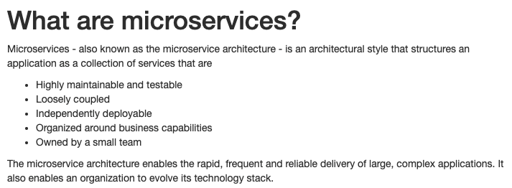
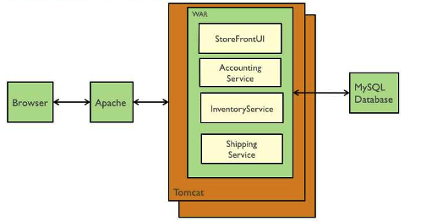
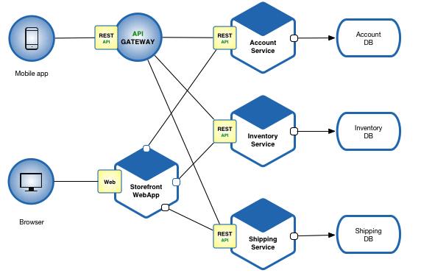
Microservices (https://microservices.io/index.html)
Microservice benefits relative to monoliths are hard to understand without having developed and maintained monoliths.
Cars are “cool.” Cars are totally, super cool if you had to go into town using a horse drawn carriage.
Microservices Architecture
Monolithic Architecture

Slide 25
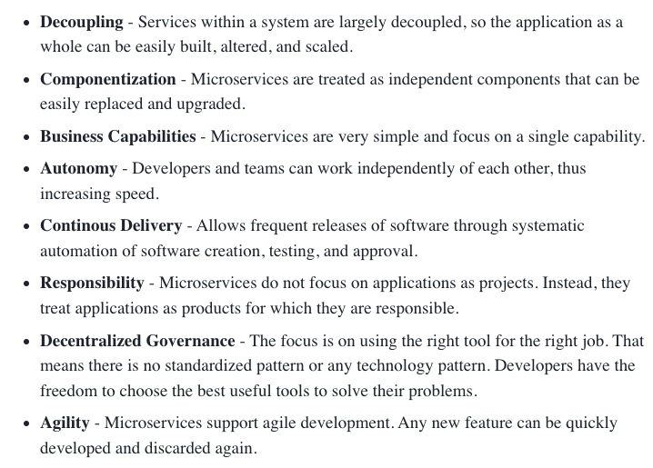
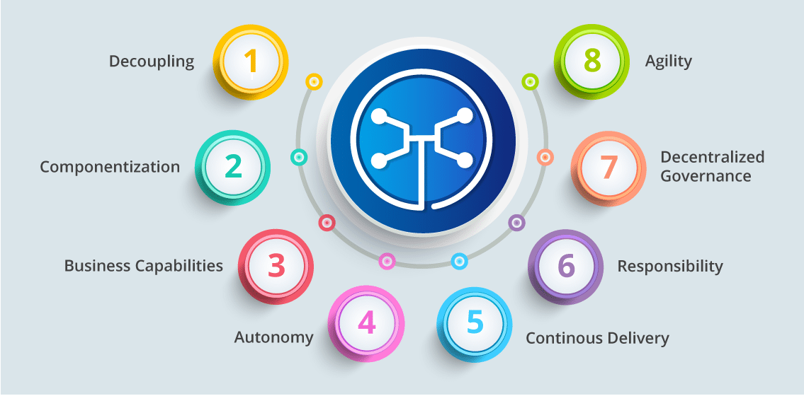
Microservice Characteristics (https://dzone.com/articles/what-is-microservices-an-introduction-to-microserv)
Microservice Characteristics

Slide 26
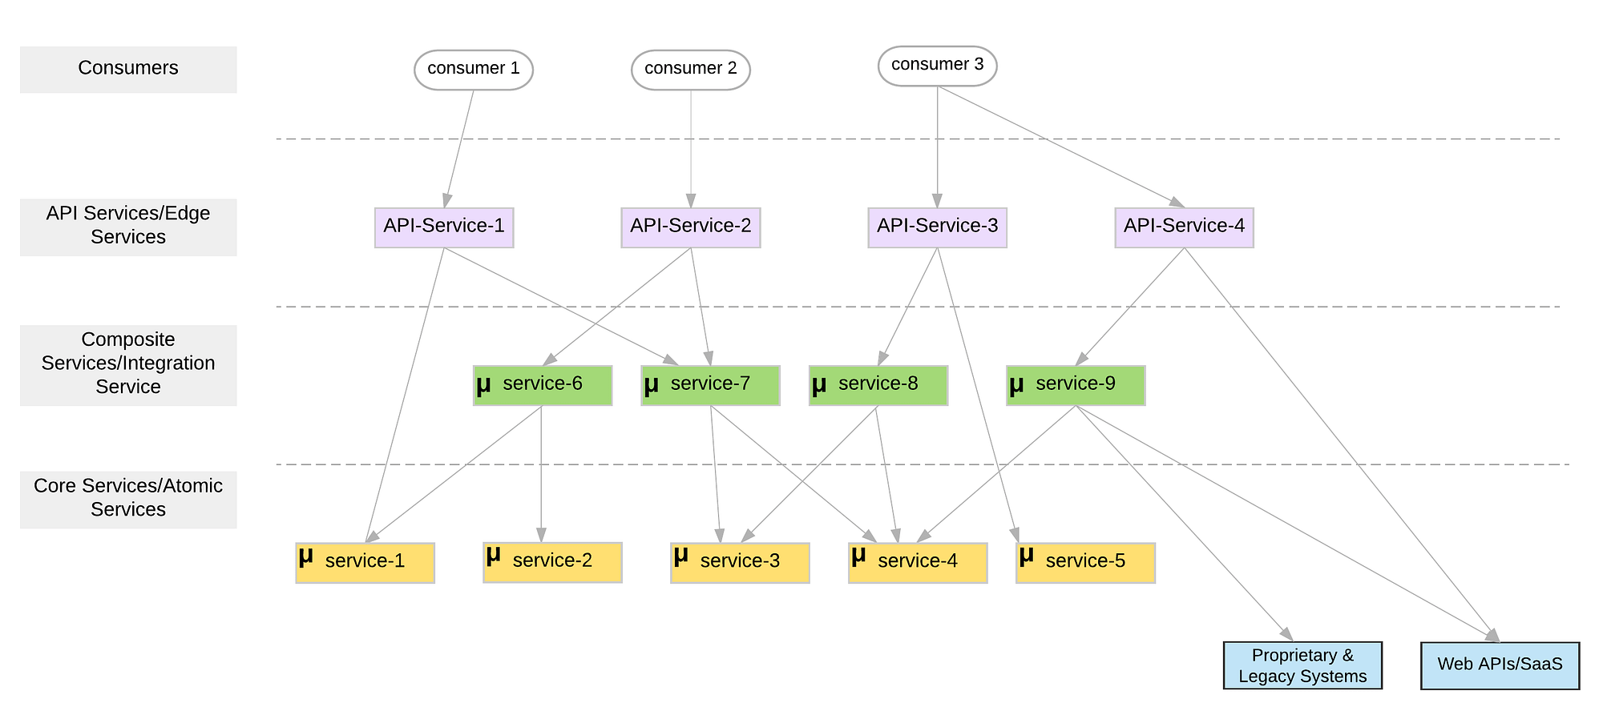
Microservice Layers (https://medium.com/microservices-in-practice/microservices-layered-architecture-88a7fc38d3f1)

Slide 27
Microservice Details and Perspectives
Some sites for good, introductory overviews and more information about microservices:
https://martinfowler.com/articles/microservices.html
https://microservices.io/
https://aws.amazon.com/microservices/
What is true of any:
Mapping, classification, taxonomy, ... ...?
Technology definition, ... ...?
Enumeration of technology pros and cons ... ...?
Answers:
“... ... it is ... ... More honor'd in the breach than the observance”
If you have three subject matter experts, you have 7 conflicting opinions.
”The most dangerous thing in the world is a 2nd LT with a map.” Like any map, it is both a way of orientating yourself and a way of having a spectacular disaster because you are studying the map instead of thinking.

Slide 28
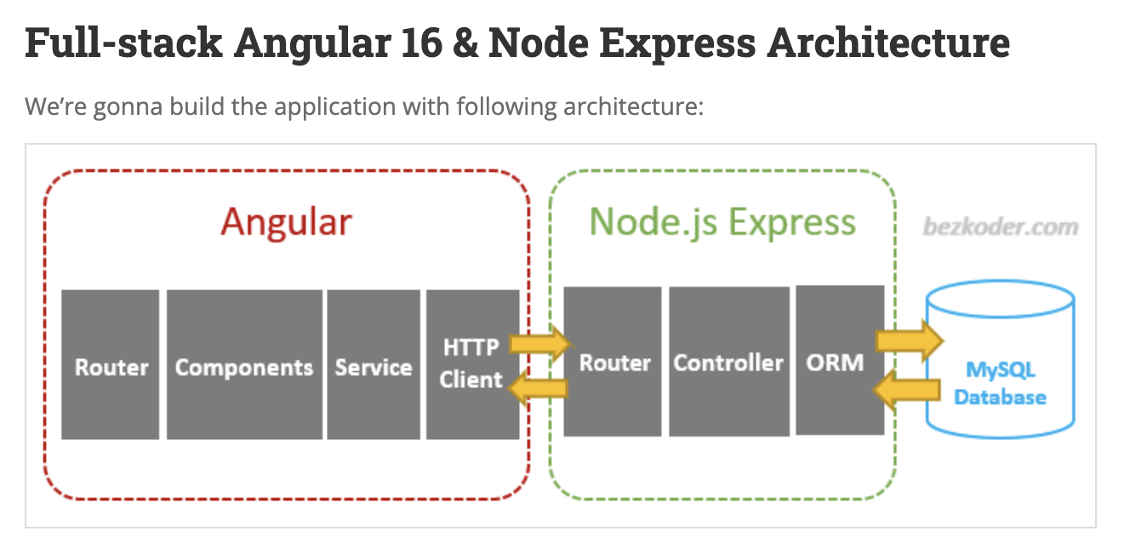
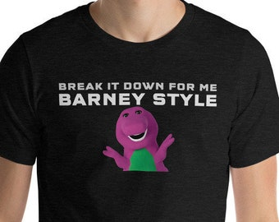
Walkthrough of a Set of Examples
I found a got set of starter examples at BezCoder.com:
Full Stack: https://www.bezkoder.com/category/full-stack/.
I will quickly walk through an example
This shows core concepts and has a lot of step-by-step guides.
I tend to use Python/FastAPI in my examples and lectures but do not provide a tutorial that ”breaks it down Barney Style.”
~/Dropbox/000/00-Current-Repos/W4153/angular-17-crud-example
~/Dropbox/000/00-Current-Repos/W4153/nodejs-express-mysql

Slide 29
Representation State Transfer (REST) Part 1

Slide 30
REST (https://restfulapi.net/)
What is REST
REST is acronym for REpresentational State Transfer. It is architectural style for distributed hypermedia systems and was first presented by Roy Fielding in 2000 in his famous dissertation.
Like any other architectural style, REST also does have it’s own 6 guiding constraints which must be satisfied if an interface needs to be referred as RESTful. These principles are listed below.
Guiding Principles of REST
Client–server – By separating the user interface concerns from the data storage concerns, we improve the portability of the user interface across multiple platforms and improve scalability by simplifying the server components.
Stateless – Each request from client to server must contain all of the information necessary to understand the request, and cannot take advantage of any stored context on the server. Session state is therefore kept entirely on the client.
Cacheable – Cache constraints require that the data within a response to a request be implicitly or explicitly labeled as cacheable or non-cacheable. If a response is cacheable, then a client cache is given the right to reuse that response data for later, equivalent requests.
Uniform interface – By applying the software engineering principle of generality to the component interface, the overall system architecture is simplified and the visibility of interactions is improved. In order to obtain a uniform interface, multiple architectural constraints are needed to guide the behavior of components. REST is defined by four interface constraints: identification of resources; manipulation of resources through representations; self-descriptive messages; and, hypermedia as the engine of application state.
Layered system – The layered system style allows an architecture to be composed of hierarchical layers by constraining component behavior such that each component cannot “see” beyond the immediate layer with which they are interacting.
Code on demand (optional) – REST allows client functionality to be extended by downloading and executing code in the form of applets or scripts. This simplifies clients by reducing the number of features required to be pre-implemented.

Slide 31
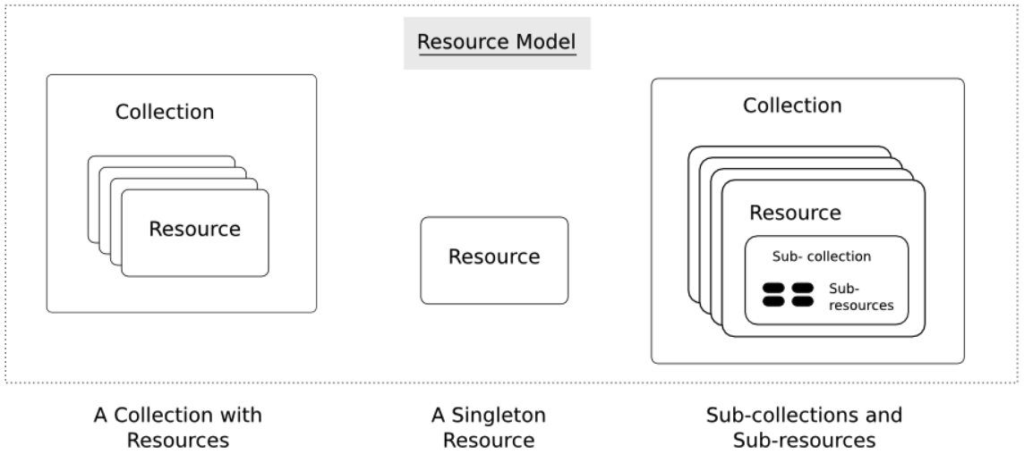
Resources
Resources are an abstraction. The application maps to create things and actions.
“A resource-oriented API is generally modeled as a resource hierarchy, where each node is either a simple resource or a collection resource. For convenience, they are often called a resource and a collection, respectively.
A collection contains a list of resources of the same type. For example, a user has a collection of contacts.
A resource has some state and zero or more sub-resources. Each sub-resource can be either a simple resource or a collection resource.
For example, Gmail API has a collection of users, each user has a collection of messages, a collection of threads, a collection of labels, a profile resource, and several setting resources.
While there is some conceptual alignment between storage systems and REST APIs, a service with a resource-oriented API is not necessarily a database, and has enormous flexibility in how it interprets resources and methods. For example, creating a calendar event (resource) may create additional events for attendees, send email invitations to attendees, reserve conference rooms, and update video conference schedules. (Emphasis added) (https://cloud.google.com/apis/design/resources#resources)
https://restful-api-design.readthedocs.io/en/latest/resources.html

Slide 32
REST – Resource Oriented
When writing applications, we are used to writing functions or methods:
openAccount(last_name, first_name, tax_payer_id)
account.deposit(deposit_amount)
account.close()
We can create and implement whatever functions we need.
REST only allows four methods:
POST: Create a resource
GET: Retrieve a resource
PUT: Update a resource
DELETE: Delete a resource
That’s it. That’s all you get.
A REST client needs no prior knowledge about how to interact with any particular application or server beyond a generic understanding of hypermedia.
“The key characteristic of a resource-oriented API is that it emphasizes resources (data model) over the methods performed on the resources (functionality). A typical resource-oriented API exposes a large number of resources with a small number of methods.” (https://cloud.google.com/apis/design/resources)

Slide 33
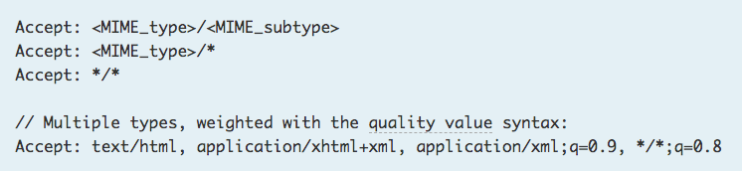
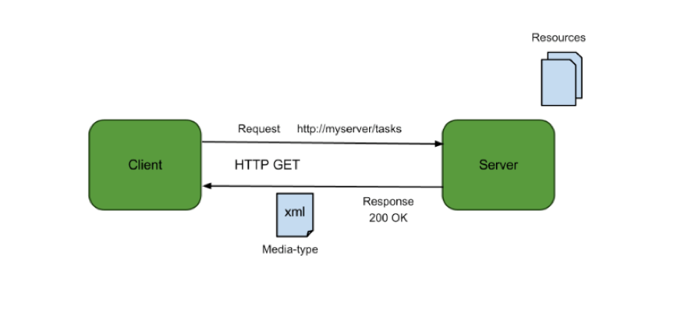
Resources, URLs, Content Types
Relative URL identifies “resource” on the server.
Server implementation maps abstract resource to tangible “thing,” file, DB row, … and any application logic.
Accept type in headers.
Client may be
Browser
Mobile device
Other REST Service
… …
Web media (content) type, e.g.
text/html
application/json

Slide 34
REST Principles
What about all of those principles?
Client/Server
Stateless
Cacheable
Uniform Interface
Layered System
Code on demand
Some of these principles
Are simple and obvious.
Are subtle and have major implications.
Stateless can be baffling, but we will cover later.
We will go into the principles in later lectures, ...
We will also go into HATEOAS, GraphQL, … …

Slide 35
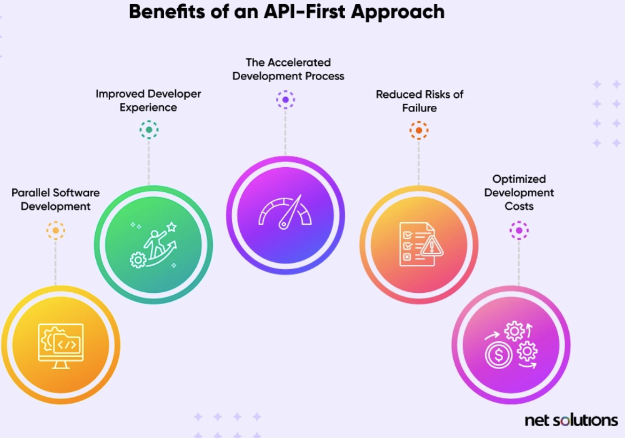
API First
“As the connective tissue linking ecosystems of technologies and organizations, APIs allow businesses to monetize data, forge profitable partnerships, and open new pathways for innovation and growth.” (McKinsey)
“API-first, also called the API-first approach, prioritizes APIs at the beginning of the software development process, positioning APIs as the building blocks of software. API-first organizations develop APIs before writing other code, instead of treating them as afterthoughts. This lets teams construct applications with internal and external services that are delivered through APIs.” (https://www.netsolutions.com/hub/mach-architecture/api-first)
Why API-First Approach?
By defining the APIs first, there is a modular separation between the services in the system. This increases the reusability of API endpoints across different parts of the system and to external entities as well (Interoperability).
The API-first approach promotes collaboration as API documentation and contract definitions serve as a common language for stakeholders such as different teams in development (e.g. frontend and backend), V&V teams for test scenarios, etc.
Creating the API contracts as part of the API-first design approach can be shared with frontend teams where the team can start building user interfaces parallelly with mocked data as per contract models, tested for the user experience. Also, codegen can be used to generate client mocks which can be directly used by client apps such as iOS/Android, etc.
It gives the flexibility for tech-stack choices. Different services or applications in the system can be in different languages as long as they adhere to API contracts. It can help in identifying the best suitable tools/options in terms of cost and performance.
With the API-First approach many concerns such as security measures, versioning, request traffic and data volume, and Integration with different services/applications within the system.
https://medium.com/@rohitranjan.pandey/api-first-design-approach-swagger-a1423db48f76

Slide 36
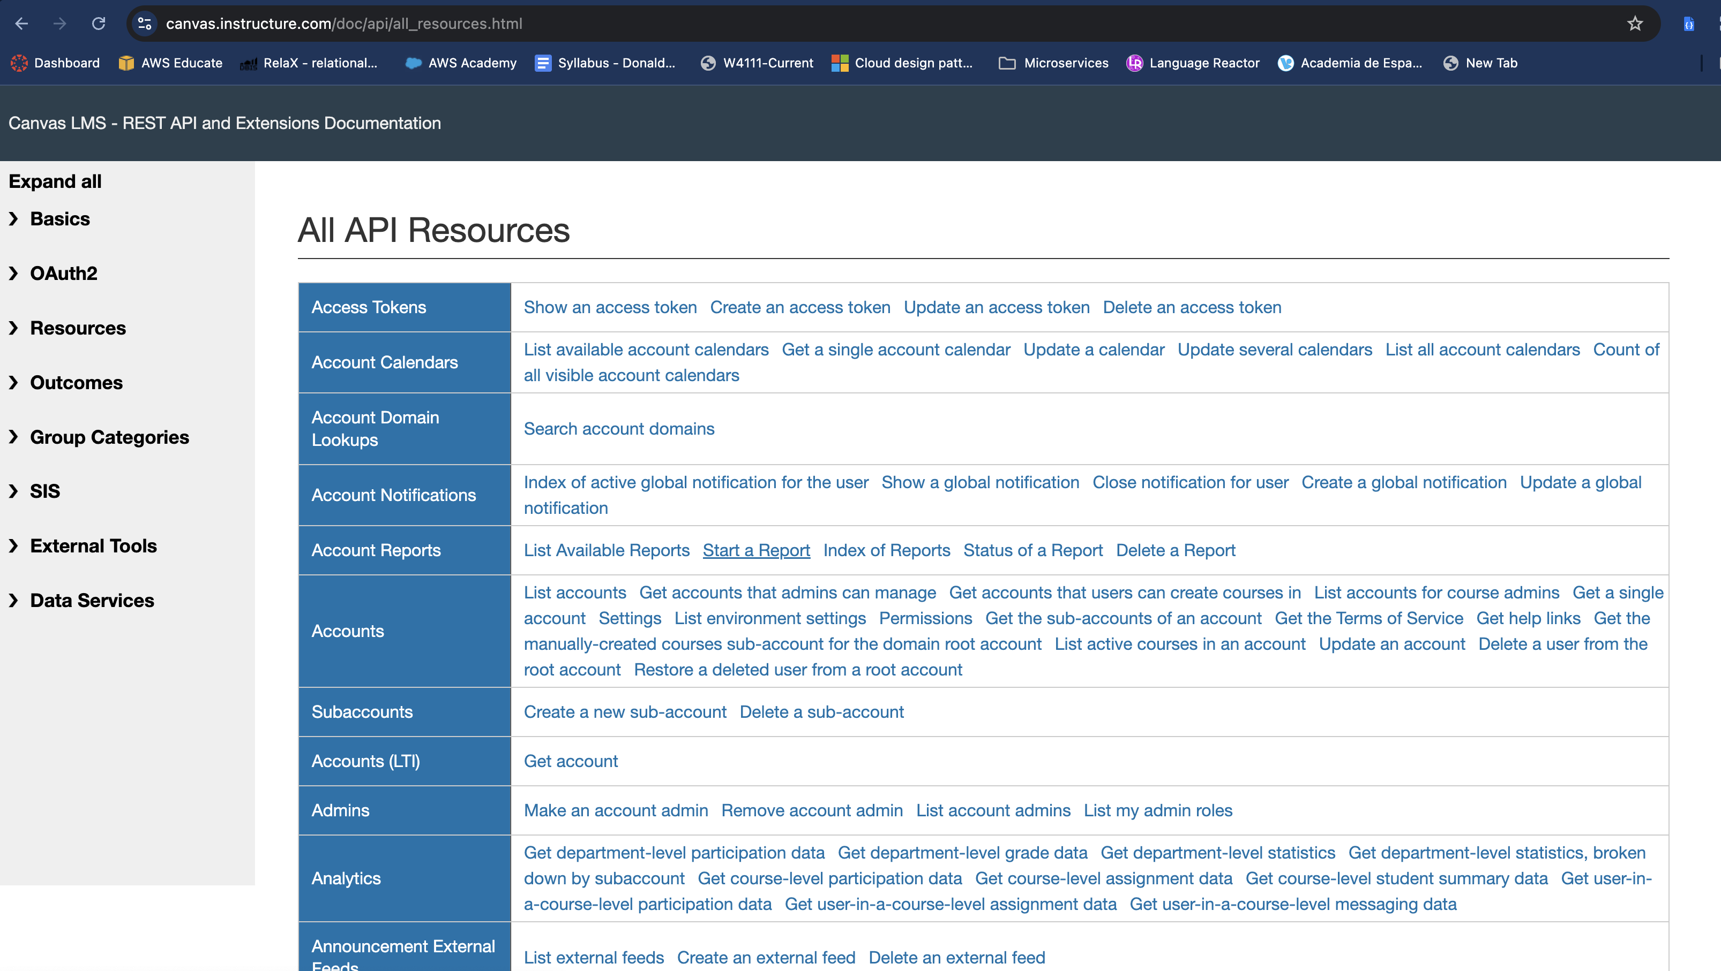
CourseWorks/Canvas LMS API

Slide 37
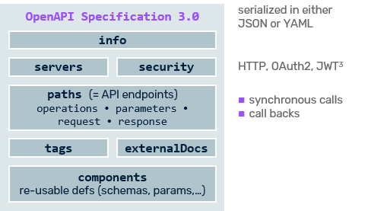
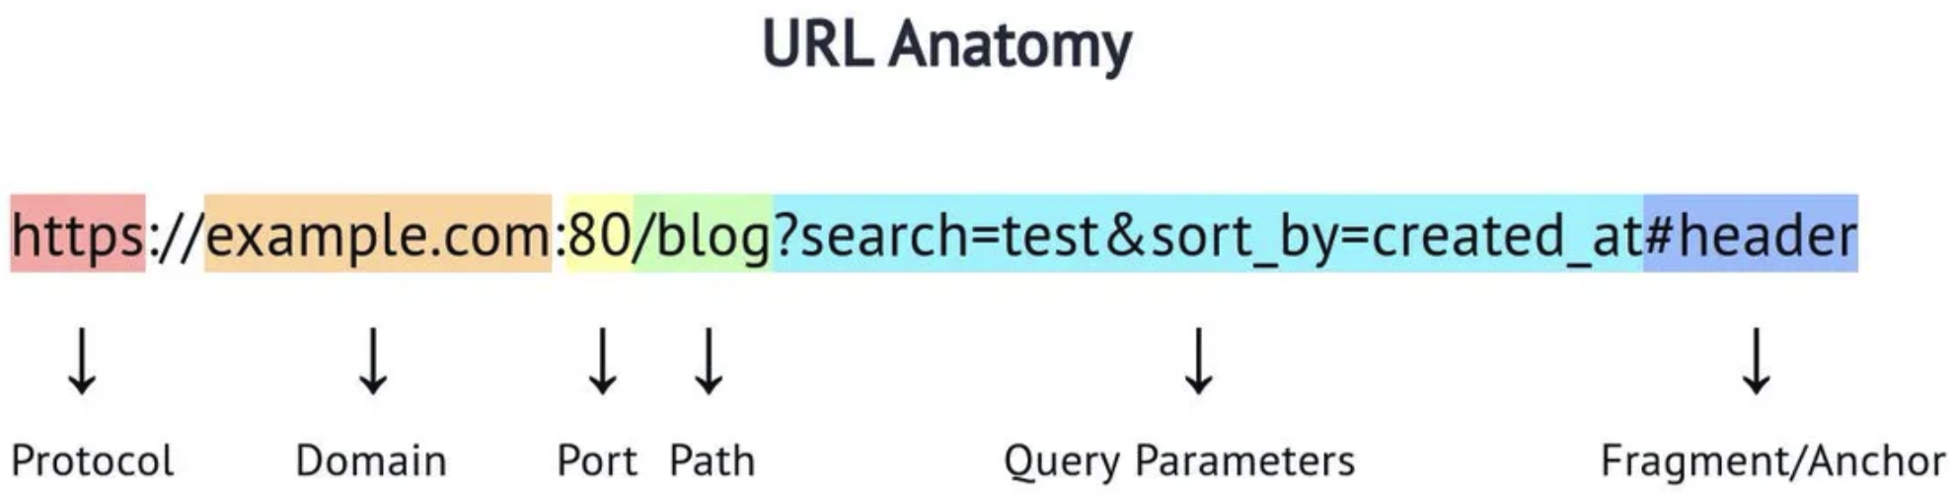
OpenAPI 3.0
OpenAPI is a standard for documenting REST APIs.
An HTTP request/response has several elements:
Protocol
Server address and port
Path
Query parameters
Fragment
Headers, Cookies
Body content and content type
Method
OpenAPI and web application frameworks introduce:
Path parameters
Models to represent bodies/content
Security information
Descriptive metadata

Slide 38
Architecture and Modeling

Slide 39
Agile Development

Slide 40
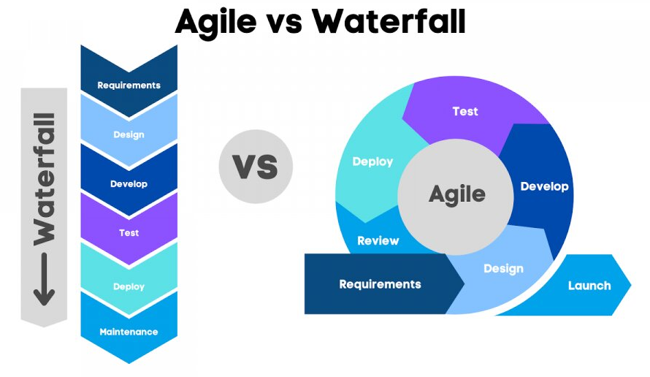
Agile Development
https://www.linkedin.com/pulse/waterfall-vs-agile-which-better-you-why-datacademy-cloud
SW projects traditionally/ previously followed a waterfall model:
12-18 months between releases.
Proceed through phases one at a time.
Modern development follows a form of agile development.
A sequence of short sprints, with a working system at the end of each sprint.
Continuous, iterative, incremental refinement and improvement.
In this course, project teams will execute in two-week sprints.
Start sprint by defining sprint objectives and user stories.
End of sprint status report and demo, which we will review.

Slide 41
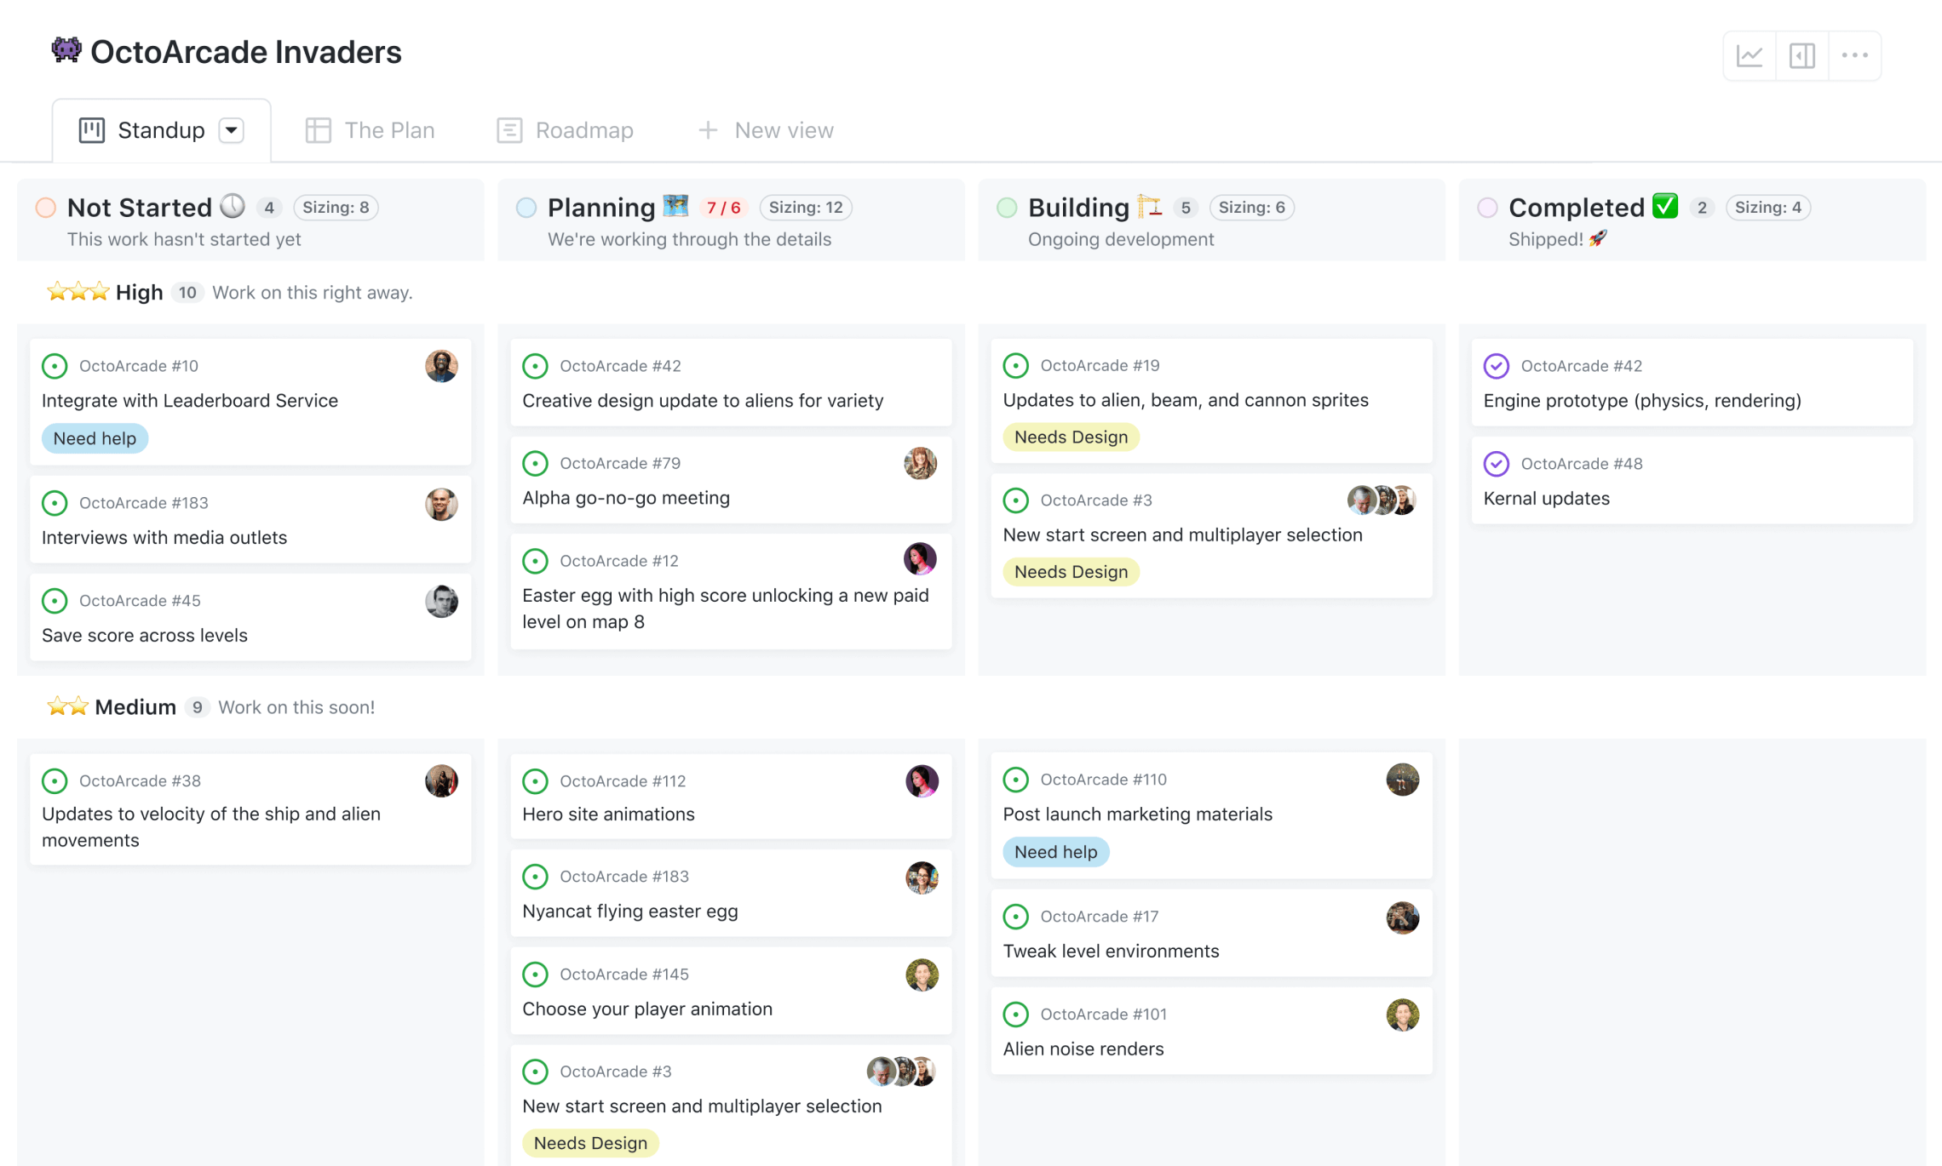
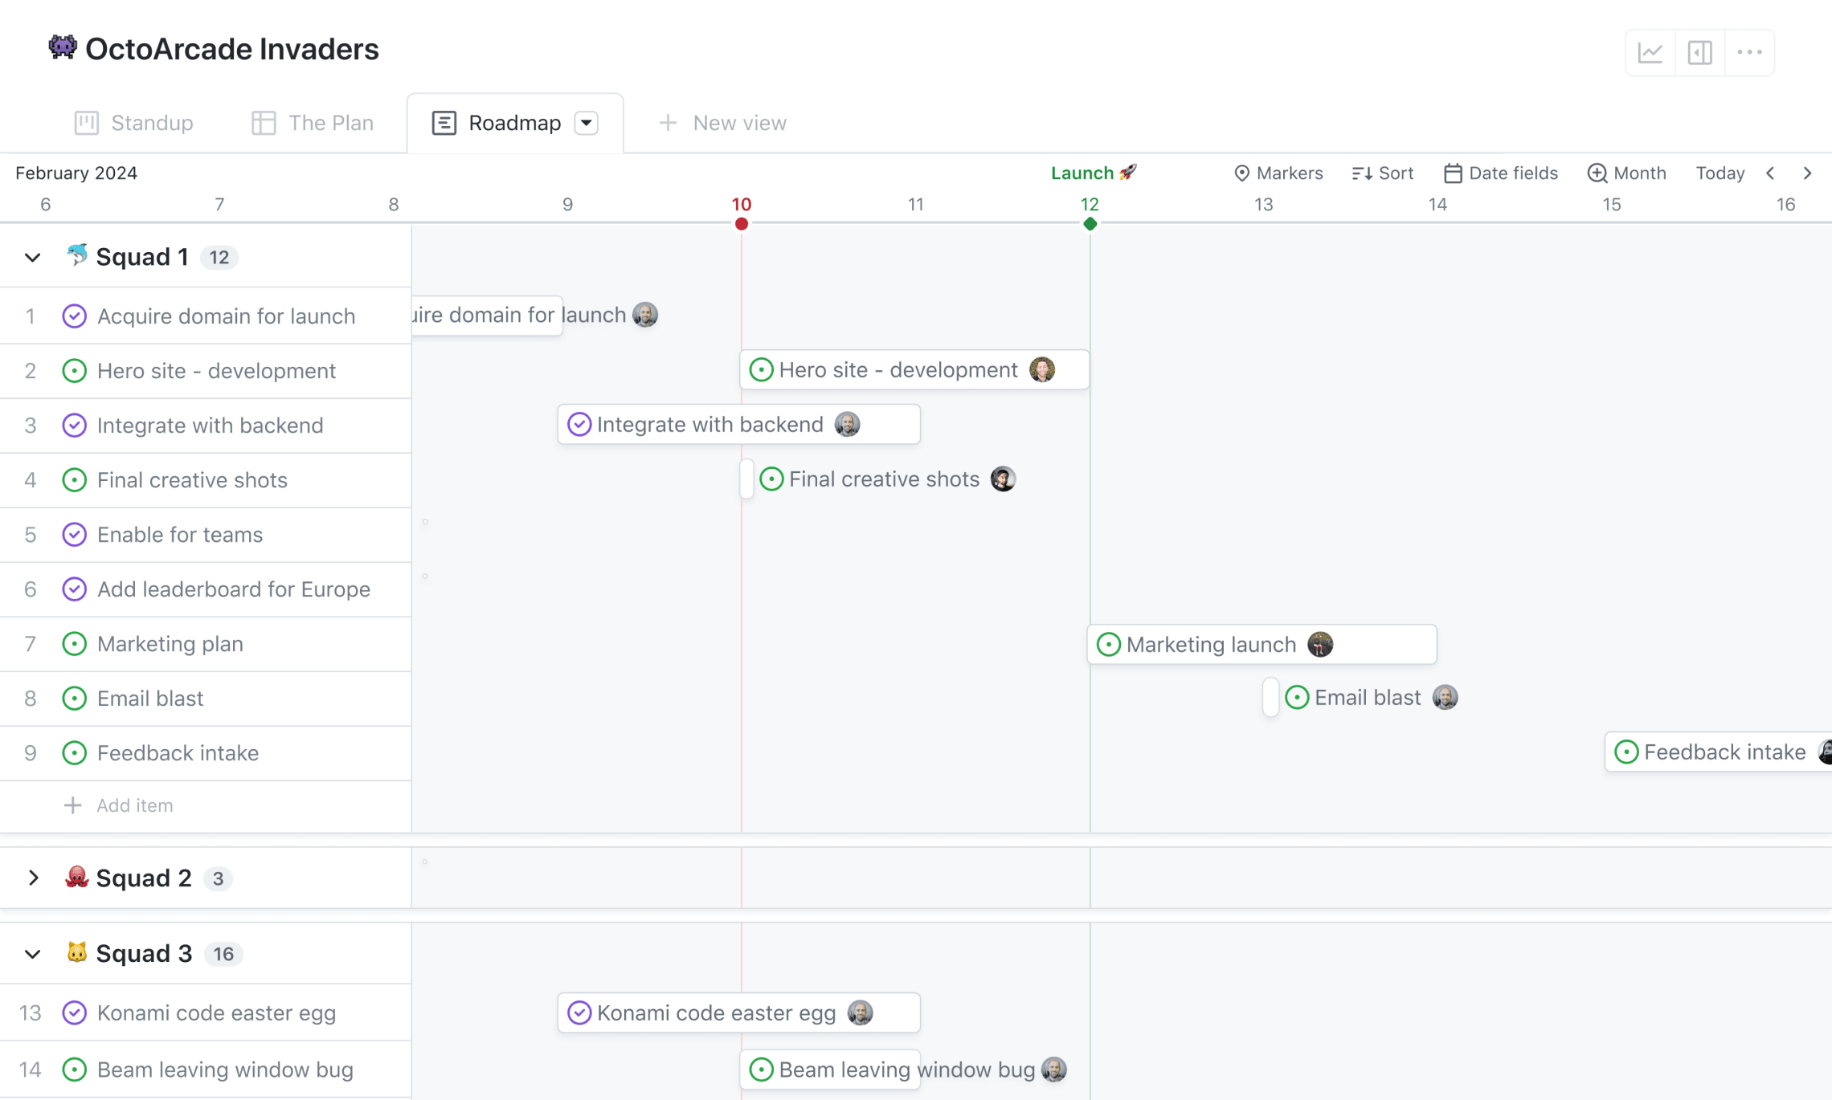
Agile and GitHub Projects
Teams will use GitHub Projects to track and manage their work.
Ideas
Issues
Backlog
Sprint
… …
The “project” will reference subprojects and code repos.
We will also get some experience with pull requests and CI/CD.

Slide 42
Next Steps

Slide 43
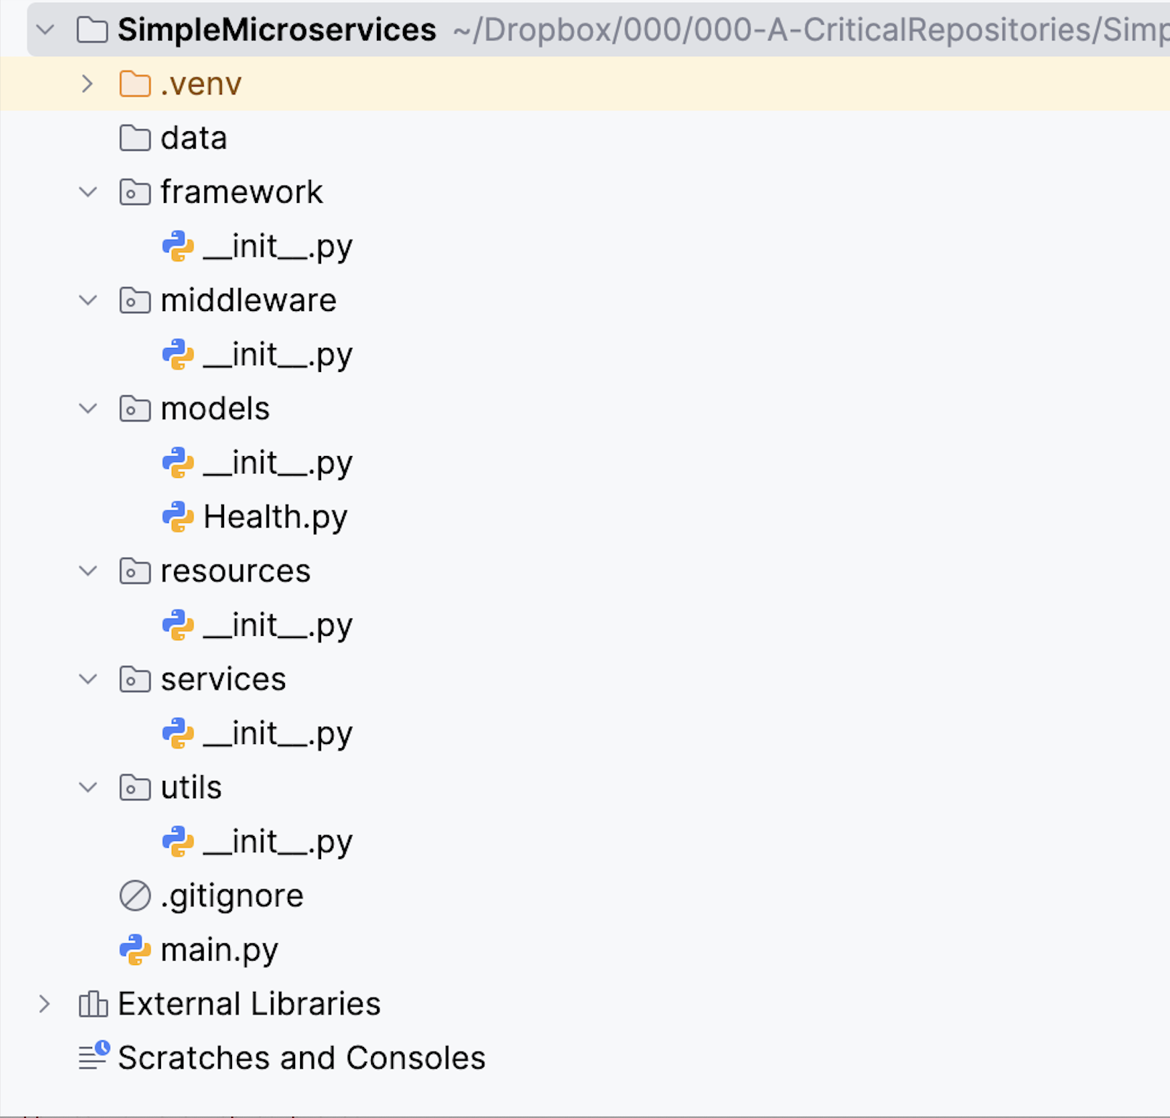
Simple Project Structure – Assignment 1
This is an individual assignment.
You will implement and test:
The FastAPI project that I demoed in class.
A GitHub repository for the code.
A project and empty Kanban.
This will require some independent study and reading, especial for metadata annotation and models.
This creates a template project that you can use for microservices that you implement in your project.
Submission
Ed and GradeScope will define the submission format.
Due at 11:59 PM 14-SEP-2025

